Slide 1
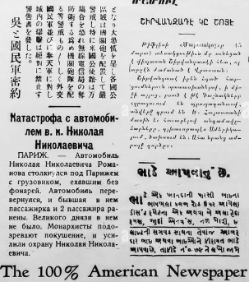
News Articles Summarization and Translation
Group 8
Members:
Lokesh Borra
Nikhil Kuchipudi
Puneet Puttu
Srilekha Sridasyam

Slide 2
Introduction
This project focuses on processing CNN articles and generate clear summaries and extract key points.
The summary generated can then be translated to Spanish, Chinese and Hindi by default and it can also translate to any other language that the user provides.
The connection between summarization and Translation saves the readers time makes the article accessible across multiple languages.

Slide 3
Problem Statement
Given the number of things that are happening around the world everyday, there is a need for automated summarization to quickly cover all the news.
Additionally, translating the news into multiple languages allows people to cover global news and keep themselves updated on geopolitical events.
Our hypothesis is that advanced models like BART and T5 can be used for achieving summaries with higher accuracies and models like GoogleTranslator can be used to achieve high-quality translations

Slide 4
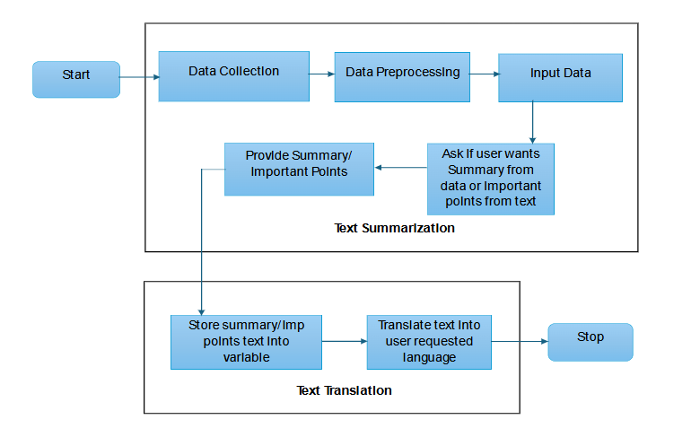
Methodology

Slide 5
Workflow - Data Preprocessing
The dataset consists of CNN articles
Each individual article can be considered a training data point for the model.
Articles have highlights in the end which basically tells us the highlights of the entire article
We need to remove them and store them in a separate variable so that it can be used to calculate Rouge scores.
This step serves as the preprocessing of our project

Slide 6
Workflow - Summarization
We used BART and T5 models for summarization.
BART is a denoising autoencoder which can be used for sequence-sequence models.
T5 is a framework for text-to-text tasks which is pre-trained on a massive dataset of text and code. It has a transformer-based architecture which can be used for variety of NLP tasks.
In our cased we used both these models to summarize our article just to compare which one works better.

Slide 7
Workflow - Important Points
We used Term Frequency – Inverse Document Frequency technique to measure the importance if words in our entire article.
We used this finding to get the sentences that are very important in the article.

Slide 8
Workflow - Translation
For translation, we used Google Translate machine translation which is a pre-trained deep learning model which can capture complex contextual dependencies.

Slide 9
Dataset Description
The dataset we used for this project is CNN Stories dataset which has a lot of CNN news articles.
Each article has a Journalists’ words and other people’s exact same words in quotation marks.
For our project we can take any one of the articles which we summarize and then translate.
In the end we have highlight points which we used for evaluating generating summaries using Rouge Scores.
Link for CNN Stories dataset

Slide 10
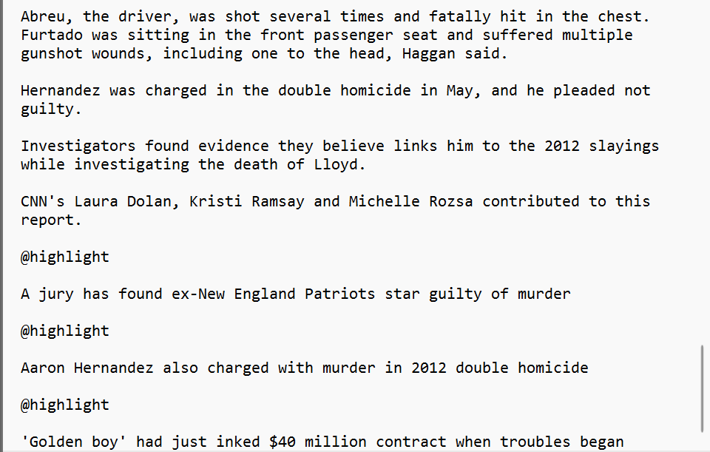
Sample Dataset Picture

Slide 11
Exploratory Data Analysis
Visualization:
Word cloud visualization shows the most repeated words in each document.
The word which are frequent are bigger in the image compared to the ones which are less frequent.
Data Preprocessing:
We removed all the highlights from the article and stored them separately to make use of them during evaluation

Slide 12
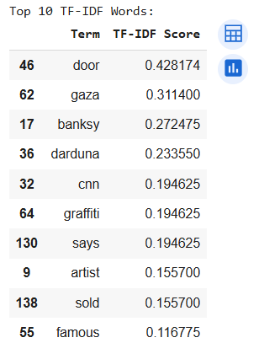
Visualization – TF-IDF values
We have extracted the top 10 important terms in the article using TD-IDF method.

Slide 13
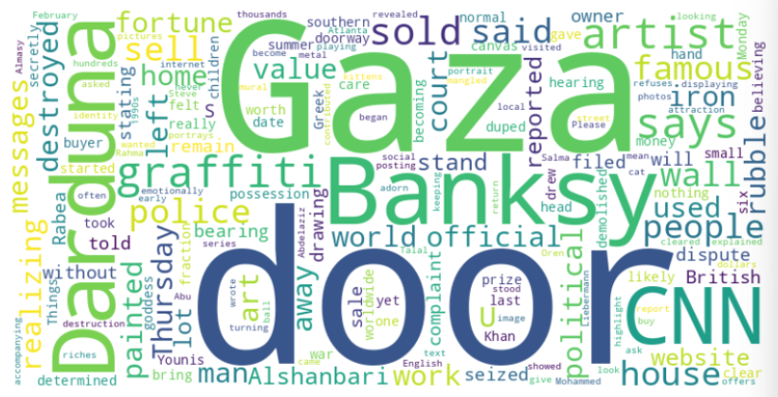
Visualization - Word Cloud
We have created a word cloud of important words in the article.

Slide 14
Implementation - Pseudocode
Step 1: Import Libraries IMPORT transformers, sklearn's TF-IDF Vectorizer, GoogleTranslator, rouge_scorer etc
Step 2: Load and Preprocess Data
LOAD CNN .story file
CLEAN text by removing markers like "@highlight"
TOKENIZE text into sentences
STORE main article text and reference highlights

Slide 15
Implementation - Pseudocode
Step 3: Summarization with BART and T5
SET summarization model (BART or T5)
IF text length > model max input length
SPLIT text into manageable chunks
FOR each chunk
GENERATE summary using the chosen model
CONCATENATE summaries for final output
DISPLAY BART summary as a paragraph
DISPLAY T5 summary as a paragraph

Slide 16
Implementation - Pseudocode
Step 4: Key Points Extraction with TF-IDF
INITIALIZE TF-IDF Vectorizer
FIT vectorizer on article text
FOR each sentence
CALCULATE importance by summing TF-IDF scores of words
SELECT top N sentences as important points
DISPLAY important points line-by-line

Slide 17
Implementation - Pseudocode
Step 5: Translation
ASK user for desired languages (ISO codes)
FOR each language
TRANSLATE BART summary, T5 summary, and important points
DISPLAY translations in paragraph format

Slide 18
Implementation - Pseudocode
Step 6: Evaluation with ROUGE Scores
DEFINE calculate_rouge(reference, generated) FUNCTION COMPUTE ROUGE-1, ROUGE-2, ROUGE-L scores using ROUGE scorer
RETURN scores

Slide 19
Implementation - Libraries Used
Transformers
GoogleTranslator
Sklearn
Rouge_score
Numpy
Wordcloud
Matplotlib

Slide 20
Implementation - Two Areas
Input News Article
Summarization of article
Translations of article

Slide 21
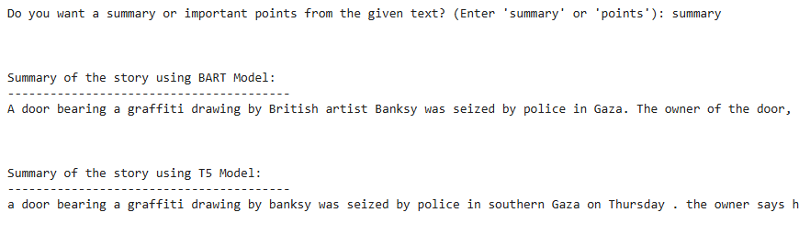
Results - BART/T5 Summary

Slide 22
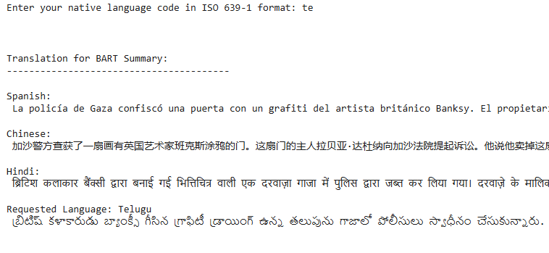
Results - BART Summary Translation

Slide 23
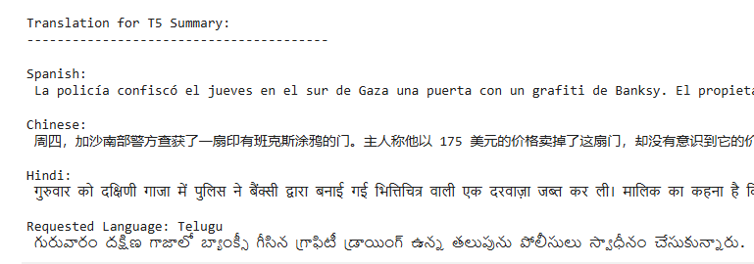
Results - T5 Summary Translation

Slide 24
Results - Evaluation
Overall, it seems that for our model BART does a better job than T5.
For Rouge-1, the scores are about 0.45 which says that about 45% of words match with reference unigram words.
For Rouge-2, the scores are about 0.17, which says that BART has captured less bigram structure from the reference.
For Rouge-L, the scores are also moderate around 0.25, showing that BART captured some structural similarity with the reference.

Slide 25
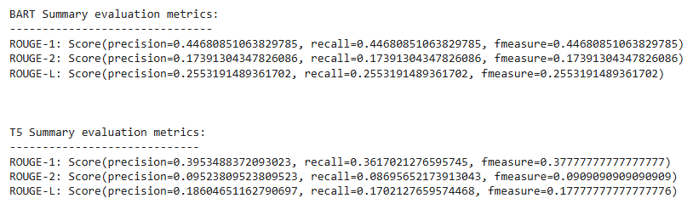
Results - Evaluation Metrics

Slide 26
Project Management
Work Completed:
We have successfully implemented Summarization and Translation as stated.
Responsibilities:
Preprocessing, BART - Lokesh - 25%
TF-IDF, Word cloud, T5 - Nikhil - 25%
Translations - Puneet - 25%
Rouge Metrics - Srilekha - 25%

Slide 27
Project Management
Issues we faced:
BART and T5 models gave a lot of input size and output size errors.
we fixed them by making chunks of the input text and then sending chunks of data to the models.
We could not find a way to evaluate models as there is no human summaries for all 90k stories.
The solution we produced was to use the highlight sentences as a baseline/reference for getting Rouge metrics.

Slide 28
References
M. Asmitha, C. R. Kavitha and D. Radha, "Summarizing News: Unleashing the Power of BART, GPT-2, T5, and Pegasus Models in Text Summarization," 2024 4th International Conference on Intelligent Technologies (CONIT), Bangalore, India, 2024, pp. 1-6, doi: 10.1109/CONIT61985.2024.10626617.
https://pypi.org/project/deep-translator/
https://www.geeksforgeeks.org/understanding-tf-idf-term-frequency-inverse-document-frequency/
https://www.freecodecamp.org/news/what-is-rouge-and-how-it-works-for-evaluation-of-summaries-e059fb8ac840/

